Slide 1
Decision Trees

Slide 2
Review steps
Load data
read.csv()
Partition to avoid overfitting
sample(), df[idx, ] etc.
Exploratory Data Analysis
summary(), plot(), table() etc.
Prepare data for modeling
Vtreat:designTreatmentsC/N(), prepare()
5. Model
Regression, Logistic Regression, KNN etc.
6. Get Results (classification or prediction)
predict()
7. Key Performance Indicators
RMSE, Accuracy, MAPE
SAMPLE
EXPLORE
MODIFY
MODEL
ANALYZE

Slide 3
Agenda
Start | End | Item
 |  | Decision Trees - explanation
 |  | Decision Tree Example
 |  | A to Z Decision Trees scripting example
 |  | Break
 |  | Random Forests

Slide 4
Decision Trees
By observing the data and splitting it into sections, rules are created for either prediction or classification problems.
Mimics a subject matter expert…pre data mining days.
Before data mining, an experienced marketing bank manager may have said “let’s call our married customers over 25 that have at least a college education to see if they want another loan.”

Slide 5
Key Ideas
Recursive partitioning: Repeatedly split the records into two sections so as to achieve maximum homogeneity of outcome within each new section
Pruning the tree: Simplify the tree by pruning peripheral branches to avoid overfitting – measure and reduce complexity

Slide 6
Advantages of Decision Trees
Understandable, rules are human readable; executives love looking at them
Light weight, fast
Easy to implement…logic can be built in Excel even
Variable selection is automatic
No assumptions of data
Works with minimal data preprocessing

Slide 7
Disadvantages of Decision Trees
Overfitting!! You could create rules down to individual records so you get perfect accuracy (100% purity in each section). This wouldn’t generalize to new unseen data.

Slide 8
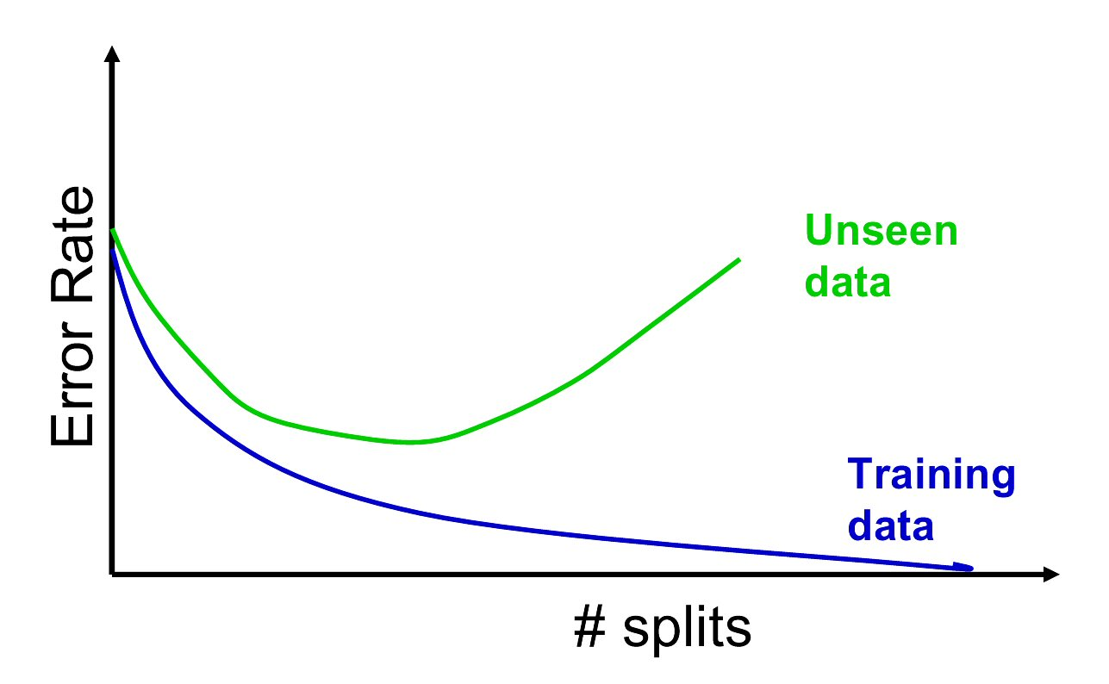
Disadvantages of Decision Trees
This is why having a training, test and holdout partition is important when making a decision tree. In production it is also important to review results of a model periodically to ensure the historical patterns aren’t evolving.

Slide 9
Recursive Partitioning Steps
Pick one of the predictor variables, x_{i}
Pick a value of x_{i,} say s_{i}, that divides the training data into two (not necessarily equal) portions
Measure how “pure” or homogeneous each of the resulting portions is
“Pure” = containing records of mostly one class (or, for prediction, records with similar outcome values)
Algorithm tries different values of x_{i,} and s_{i} to maximize purity in initial split
After you get a “maximum purity” split, repeat the process for a second split (on any variable), and so on

Slide 10
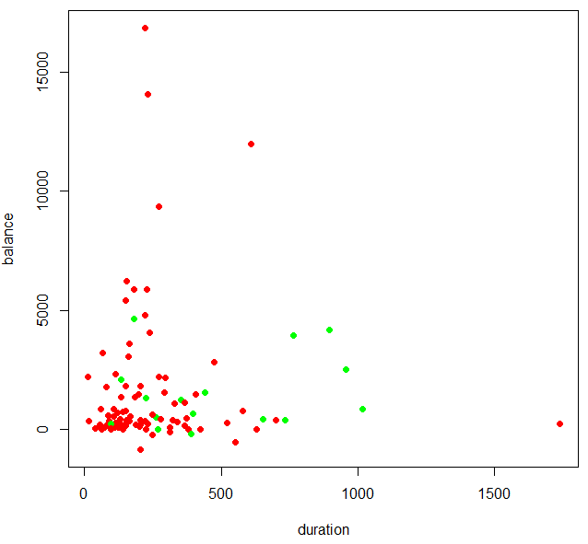
Suppose this is our data
Let’s classify offer acceptance among real bank customers using a decision tree. Green means they accepted the offer to open a new deposit account.
https://archive.ics.uci.edu/ml/datasets/bank+marketing

Slide 11
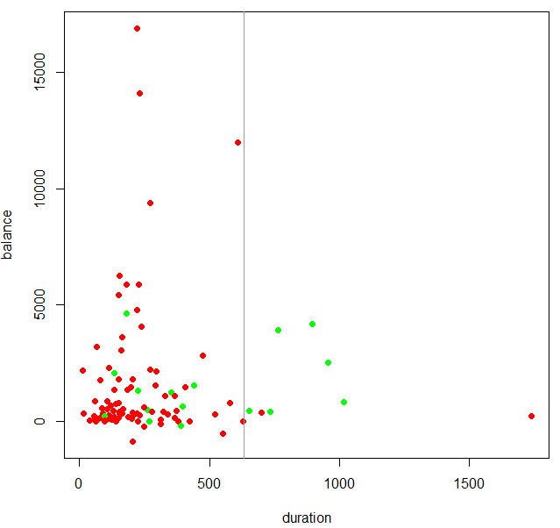
Suppose this is our data
Purity = 6 accepted among 8 offers
There are a lot of accepted offers with account holders of duration >635 days

Slide 12
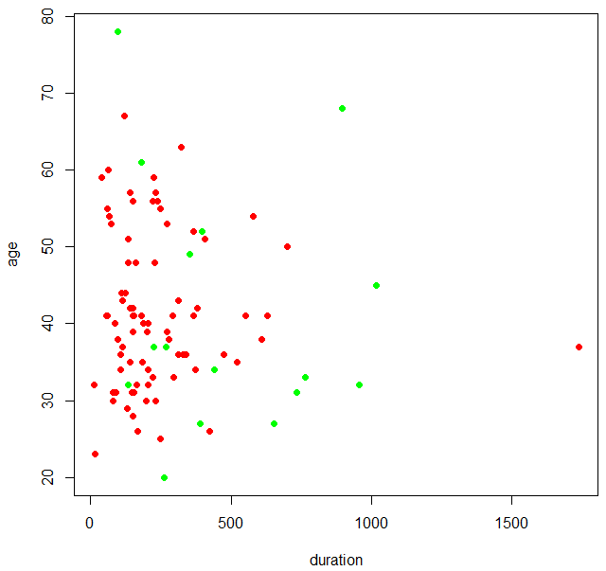
Now another dimension of the data
Here we see another dimension, age of the account holder along with duration.

Slide 13

With the rule duration > 635
The first rule still holds true but now we can think about adding new rule layers.

Slide 14

New Rule
A
B
Purity of split “A”= 6 accepted among 8 offers
Purity of split “B” = 1 of 1
In this toy example, we can add another rule stating age > 68 to capture another positive response and create another rule.

Slide 15

Our rule set is like Plinko!
With our rule tree we can score a new potential customer to call.

Slide 16
2 Rule Tree
Age > 68
No
Yes
Duration > 635
No
Yes
No (9 of 91 are positive)
Yes (6 of 8)
Yes
(1 of 1)

Slide 17
2 Rule Tree
Age > 68
Decision Node
No
Yes
Duration > 635
No
Yes
No (9 of 91 are positive)
Yes (6 of 8)
Yes
(1 of 1)
Terminal Node or “Leaf” Node

Slide 18

Let’s drop a new record down our plinko tree
Age > 68
No
Yes
Duration > 635
No
Yes
No (9 of 91)
Yes (6 of 8)
Yes
(1 of 1)

Slide 19
Let’s drop a new record down our plinko tree
Age = 39
Duration = 640
Age > 68
No
Yes
Duration > 635
No
Yes
No (9 of 91)
Yes (6 of 8)
Yes
(1 of 1)

Slide 20
Let’s drop a new record down our plinko tree
The age was less than 68 so the record drops to the next decision point.
Age > 68
Age = 39
Duration = 640
No
Yes
Duration > 635
No
Yes
No (9 of 91)
Yes (6 of 8)
Yes
(1 of 1)

Slide 21
Let’s drop a new record down our plinko tree
The duration is greater than 635 so the record lands at YES with a probability of 75% (6/8).
Age > 68
No
Yes
Duration > 635
No
Yes
Age = 39
Duration = 640
No (9 of 91)
Yes (6 of 8)
Yes
(1 of 1)

Slide 22
2 Rule Tree
Age = 39
Duration = 640

Slide 23
Let’s drop another record down our plinko tree
Age = 25
Duration = 365
Age > 68
No
Yes
Duration > 635
No
Yes
No (9 of 91)
Yes (6 of 8)
Yes
(1 of 1)

Slide 24
Let’s drop a new record down our plinko tree
The age was less than 68 so the record drops to the next decision point.
Age > 68
Age = 25
Duration = 365
No
Yes
Duration > 635
No
Yes
No (9 of 91)
Yes (6 of 8)
Yes
(1 of 1)

Slide 25
Let’s drop a new record down our plinko tree
Now the duration is less than 635 so the record drops to the terminal “NO” and has a probability of accepting the loan offer of ~10%
Age > 68
No
Yes
Duration > 635
No
Yes
Age = 25
Duration = 365
No (9 of 91)
Yes (6 of 8)
Yes
(1 of 1)

Slide 26
2 Rule Tree
Keep in mind a different algorithm may have come to a different conclusion…what about KNN? Also, adding more rules may find the local structure closer to this point so some judgment must still be made when constructing a tree.
Age = 25
Duration = 365

Slide 27
How a decision tree really splits data.
Order records according to one variable, say duration
Take a predictor value, say 600 (from the first record) and divide records into those with duration >= 600 and those < 600
Measure resulting purity (homogeneity) of class in each resulting portion
Try all other split values within the duration vector (column)
Repeat for other variable(s)
Select the one variable & split that yields the most purity
Since it splits at various values within a single vector, there is no need to standardize (center, scale, normalize).
Complexity of the tree has to do with the number of layers allowed & the size, how many records, within each terminal node

Slide 28
An example of overfitting…
2 rules still have some impurity in each section. Maybe we should keep adding rules.

Slide 29
An example of overfitting…
Adding this rule improves the purity
Age < 22

Slide 30
An example of overfitting…
These additional rules look like they help too.
Age > 62
Duration > 1100
Age < 22

Slide 31
An example of overfitting…
Great these rules are 100% pure! Our decision tree is perfect.
WRONG! Some of the rules were made for a single marketing offer. We fit to closely to the local structure so when we need to make a decision in the future this model wont be as accurate!
Age >38
Age <39
Duration >225
Duration < 300
Perfect node, but this is a rather specific customer case.

Slide 32
cp- complexity parameter
The cp value measures the size of the tree compared to its ability to separate the data. The tree will grow until the next split doesn’t reduce the cp value…meaning that split added more complexity than is gained from the purity of the node.
cp | complexity parameter. Any split that does not decrease the overall lack of fit by a factor of cp is not attempted. For instance, with anova splitting [regression], this means that the overall R-squared must increase by cp at each step. The main role of this parameter is to save computing time by pruning off splits that are obviously not worthwhile. Essentially,the user informs the program that any split which does not improve the fit by cp will likely be pruned off by cross-validation, and that hence the program need not pursue it.
Setting cp to a negative amount ensures that the tree will be fully grown.

Slide 33
minsplit – minimum split parameter
minsplit | the minimum number of observations that must exist in a node in order for a split to be attempted.
Age > 68
Split minimum number of observations at a decision node.
No
Yes
Duration > 635
No
Yes
No (9 of 91)
Yes (6 of 8)
Yes
(1 of 1)

Slide 34
minbucket – minimum bucket parameter
minbucket | the minimum number of observations in any terminal <leaf> node. If only one of minbucket or minsplit is specified, the code either sets minsplit to minbucket*3 or minbucket to minsplit/3, as appropriate.
Age > 68
No
Yes
Duration > 635
Split minimum number of observations at a terminal node.
No
Yes
No (9 of 91)
Yes (6 of 8)
Yes
(1 of 1)

Slide 35
Open A_Bank Loans Decision Tree.R

Slide 36


Your Data Mining Toolbox
Previous Lessons
Some R Programming (R-studio)
EDA (summaries, column and row exploration)
Knowledge of Data Preparation (vtreat)
Basic Visualization (plot, ggplot)
Regression (continuous predictions)
Binary Classification (logistic regression)
Today
Decision Trees (continuous & classification – binary or multi
DT, LogReg & Reg are excellent modeling tools. Not bad for 6 classes!

